Slide 1
Physics 496
Introduction to Physics Research

Slide 2
Physics 496
“Introduction to Physics Research”
Instructors: Nadya Mason nadya@Illinois.edu
Celia Elliott cmelliot@Illinois.edu
Alternate Titles:
  “Effective Communication in Science”
  “Rhet 3.141592654”
  “A hodgepodge of what physicists/scientists should know”
  “Things I wished my advisor had told me”
  “How to navigate the science world”

Slide 3
Our goals for you in PHYS496
  Help you learn methods to write and present persuasively
    The scientific community (and just about everyone else!) tends to be skeptical, so you can’t rely just on great results!
    “Writing is the way we learn” – C.M. Elliott
  Help you learn to navigate the scientific literature
    Researching existing literature is critical for understanding progress, planning future work, writing proposals, writing papers, etc.
  Teach you how the “world of science” works
  Colloquia, research areas, ethics, …
  Help you learn to think critically
  About others work and yours!
We want to teach you how to become effective scientists and communicators!

Slide 4

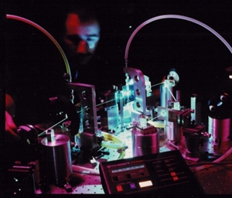


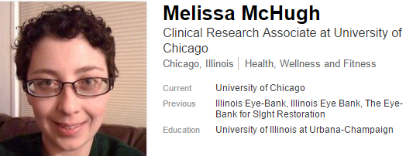
PHYS496
Useful if you want to go to graduate school, academia
Useful for graduate school, industry
Useful for undergraduate degree, industry
Useful for undergraduate degree, anything!

Slide 5
Components of the Course
  Writing, Speaking, & Presentation Skills
    Writing Workshops, Journal Club, Colloquium Reports, Figures, Communicating with non-scientists,…
  Resources for Scientists
    How to use on-line databases useful for research
  Scientific Ethics
    Case studies
  Exposure to Physics Research & Careers
  Speakers, Colloquia, Journal Club

Slide 6
Our expectations of you
  In-class participation: mandatory attendance
  Written assignments
    Don’t start too late!
    We prefer a Word file via email, but an emailed pdf file is OK
  Feedback on your classmate’s writing
  Oral presentations
    Professional and polished
    Plan to use PowerPoint (sent to me via email) on my laptop
  (Enthusiasm!)

Slide 7
Plagiarism
Never copy phrases longer than 3-4 words
Never copy phrases longer than 3-4 words
Providing a citation to a bibliographic entry
or footnote does not make copying words OK
Figure captions
Text from published paper
Includes:
Text from paper you are working on with advisor
Websites

Slide 8
Direct Quotes
Professor Mason said “Never copy
phrases longer than 3-4 words.”
Uncommon in technical writing
You can only quote words that someone said in person, in an email, over the phone, or in a letter to you.

Slide 9



Comments
You will get out as much as you put in
Talk with us if you have questions
regarding homework, plagiarism, life/career issues, …
This course is an opportunity to ask us questions about whatever you’d like to know regarding Physics, careers, communication, publishing, funding, …

